Slide 1
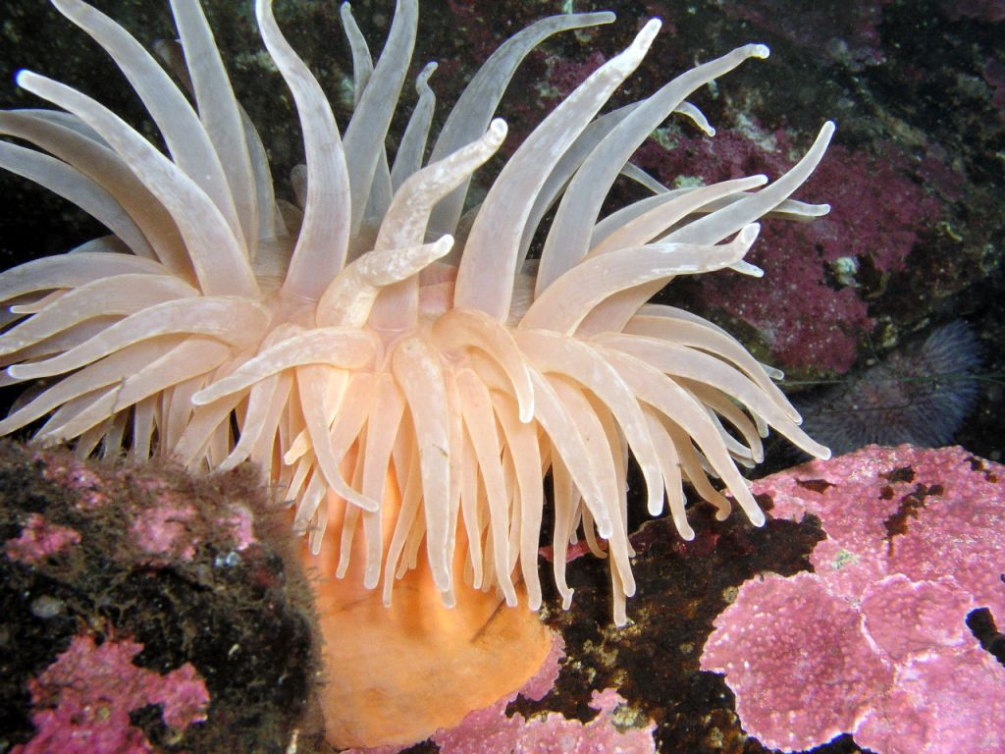

Sea anemone
By: Kevin Jackman

Slide 2
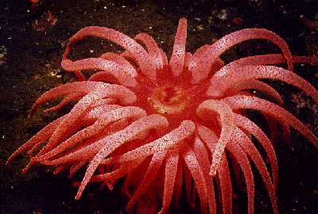
Sea @nemone origin
The sea anemone has many different types of its kind
The scientific name for the crimson anemone is Cribrinopsis Fernaldi
This type of color of the anemone can range from red to pale yellow to white.

Slide 3
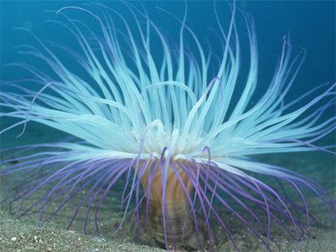
Gettin’ physical
The sea anemones physical characteristics are very cool
The anemone looks like a flower and comes in all different colors
The sea anemones tentacles flow with the current of the ocean.
These anemone are also cnidarians which mean they have stinging tentacles

Slide 4
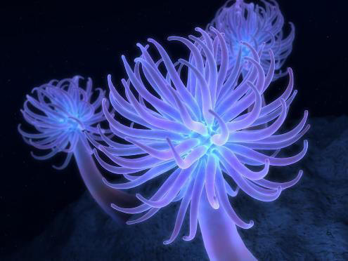
Where do they liv’
The sea anemone is a sessile creature for the most part
If it doesn’t like the environment its living in it just floats to another rock or piece of ground it likes

Slide 5
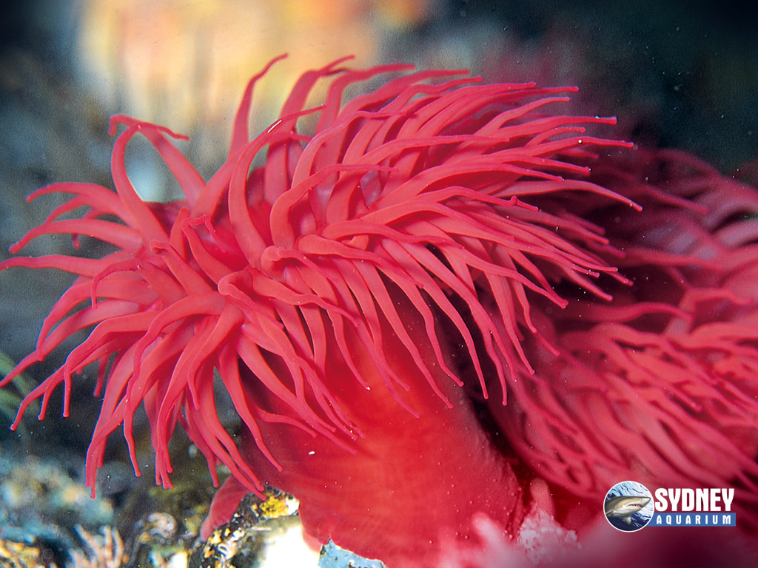
Makin’ families
The sea anemone is hermaphroditic, this means it can be both boy or girl
The sea anemone buds off the baby anemone when it reproduces
It holds the sea anemone till it is ready to be on its own

Slide 6
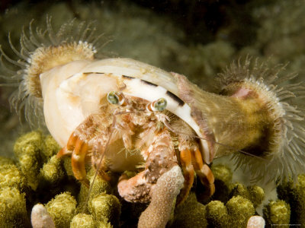
@nemone adptation$
The sea anemone adapted to its own benefit and crabs benefit
The anemone can attach themselves to crabs and protect the crab
This is also a good way for it to get food

Slide 7
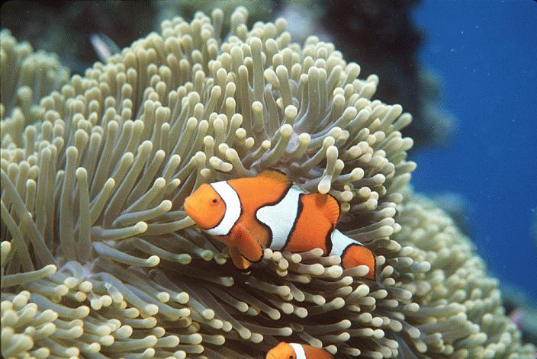
M@rlin n’ N3mo
Some interesting facts about the sea anemone is that the sea anemone lets the clown fish live in it.
The clown fish clean the anemone by eating bacteria.
The tentacles also do not affect the clown fish because of a mucus wall type substance.

Slide 8
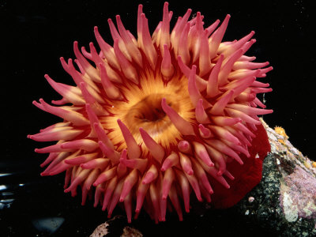
How they eat
The sea anemone
Has stinging tentacles that it uses to stun their prey then eat it
Their tentacles also grab on to its prey and bring it into the center of itself to eat it
here’s a video to show you

Slide 9
Mmmmmmmmmmmmmmm!! :p

